Slide 1
Chapter 2: Intro to Relational Model

Slide 2
Outline
Structure of Relational Databases
Database Schema
Keys
Schema Diagrams
Relational Query Languages
The Relational Algebra
Notes:
1

Slide 3
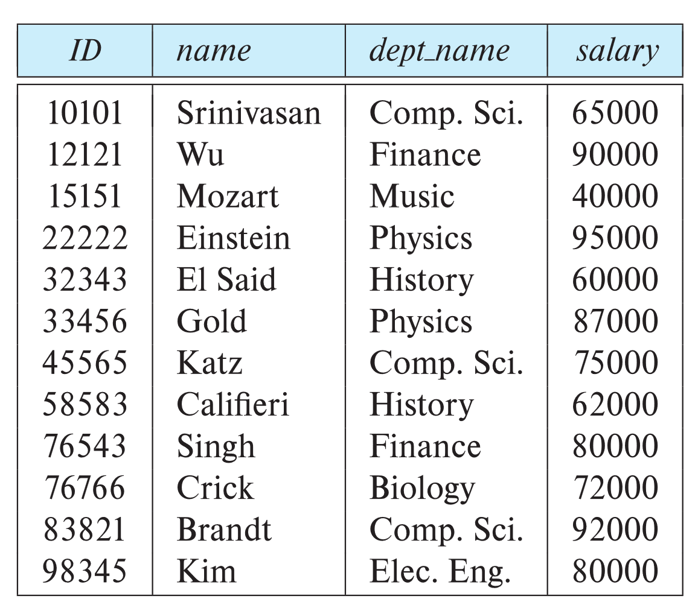
Example of a Instructor Relation
attributes
(or columns)
tuples
(or rows)

Slide 4
Relation Schema and Instance
A₁, A₂, …, A_{n} are attributes
R = (A₁, A₂, …, A_{n} ) is a relation schema
Example:
instructor = (ID, name, dept_name, salary)
A relation instance r defined over schema R is denoted by r (R).
Example: customer(Customer_schema)
The current values a relation are specified by a table
An element t of relation r is called a tuple and is represented by a row in a table
Notes:
1

Slide 5
Attributes
Each attribute of a relation has a name
The set of allowed values for each attribute is called the domain of the attribute
Attribute values are (normally) required to be atomic; that is, indivisible
E.g., the value of an attribute can be an account number, but cannot be a set of account numbers
A domain is said to be atomic if all its members are atomic
The special value null is a member of every domain. Indicated that the value is “unknown”
The null value causes complications in the definition of many operations
We will ignore the effect of null values in our main presentation and consider their effect later

Slide 6
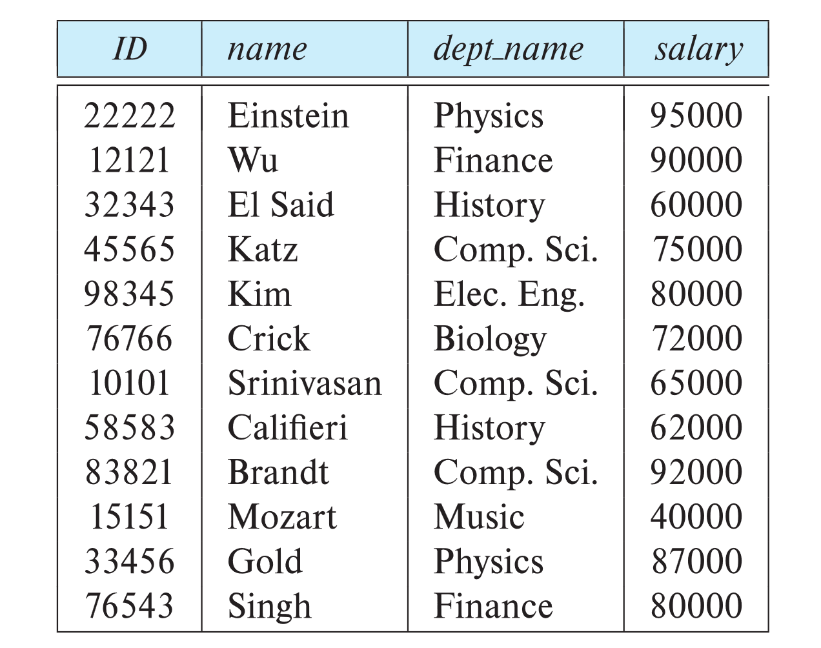
Relations are Unordered
Order of tuples is irrelevant (tuples may be stored in an arbitrary order)
Example: instructor relation with unordered tuples

Slide 7
Database
A database consists of multiple relations
Information about an enterprise is broken up into parts, with each relation storing one part of the information
account: stores information about accounts
depositor: stores information about which customer owns which account
customer: stores information about customers
Storing all information as a single relation, such as
bank(account_number, balance, customer_name,...)
Result in
Repetition of information
E.g., if two customers own an account (What gets repeated)
The need for null values
E.g., two represent a customer without an account
Normalization theory (Chapter 7) deals with how to design relation schemas

Slide 8
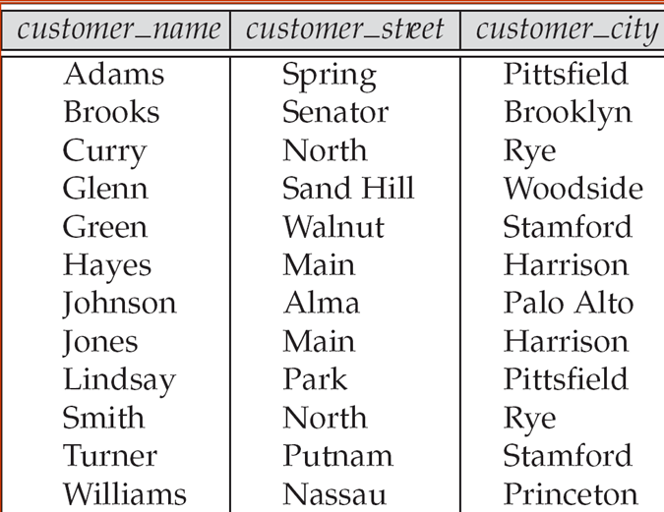
The customer Relation

Slide 9
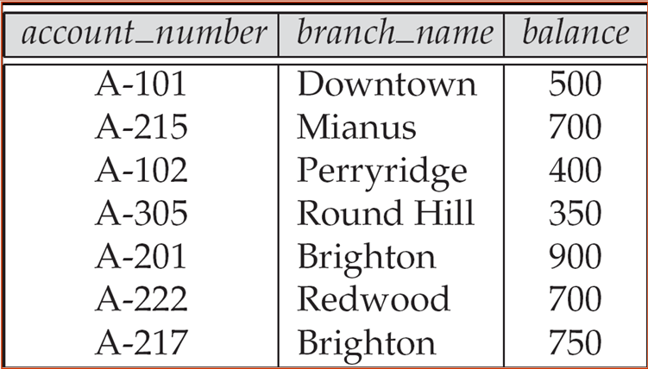
The account Relation

Slide 10
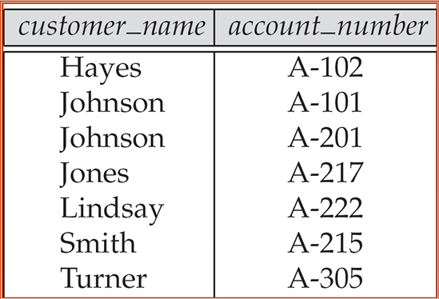
The depositor Relation

Slide 11
Database Schema
Database schema -- is the logical structure of the database.
Database instance -- is a snapshot of the data in the database at a given instant in time.
Example:
schema: instructor (ID, name, dept_name, salary)
Instance:

Slide 12
Keys
Let K ⊆ R
K is a superkey of R if values for K are sufficient to identify a unique tuple of each possible relation r(R)
Example: {ID} and {ID,name} are both superkeys of instructor.
Superkey K is a candidate key if K is minimal Example: {ID} is a candidate key for Instructor, since it is a superkey and no subset of it is a superkey.
One of the candidate keys is selected to be the primary key.
Should choose an attribute whose value never, or very rarely changes
E.g., email address is unique, but may change student_id never changes
Foreign key constraint: Value in one relation must appear in another
Referencing relation
Referenced relation
Example: dept_name in instructor is a foreign key from instructor referencing department

Slide 13
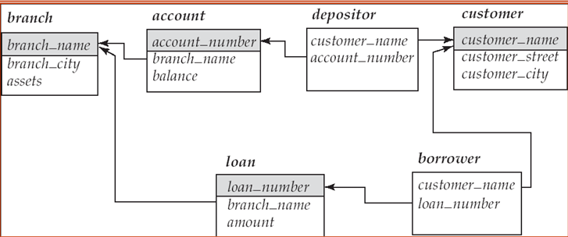
Keys (Cont.)
A relation schema may have an attribute that corresponds to the primary key of another relation. The attribute is called foreign key.
E.g., customer_name and account_number attributes of depositor are foreign keys of customer and account, respectively.
Foreign key constraint:
Only values occurring in the primary key attribute of the referenced relation may occur in the foreign key attribute of the referencing relation.

Slide 14
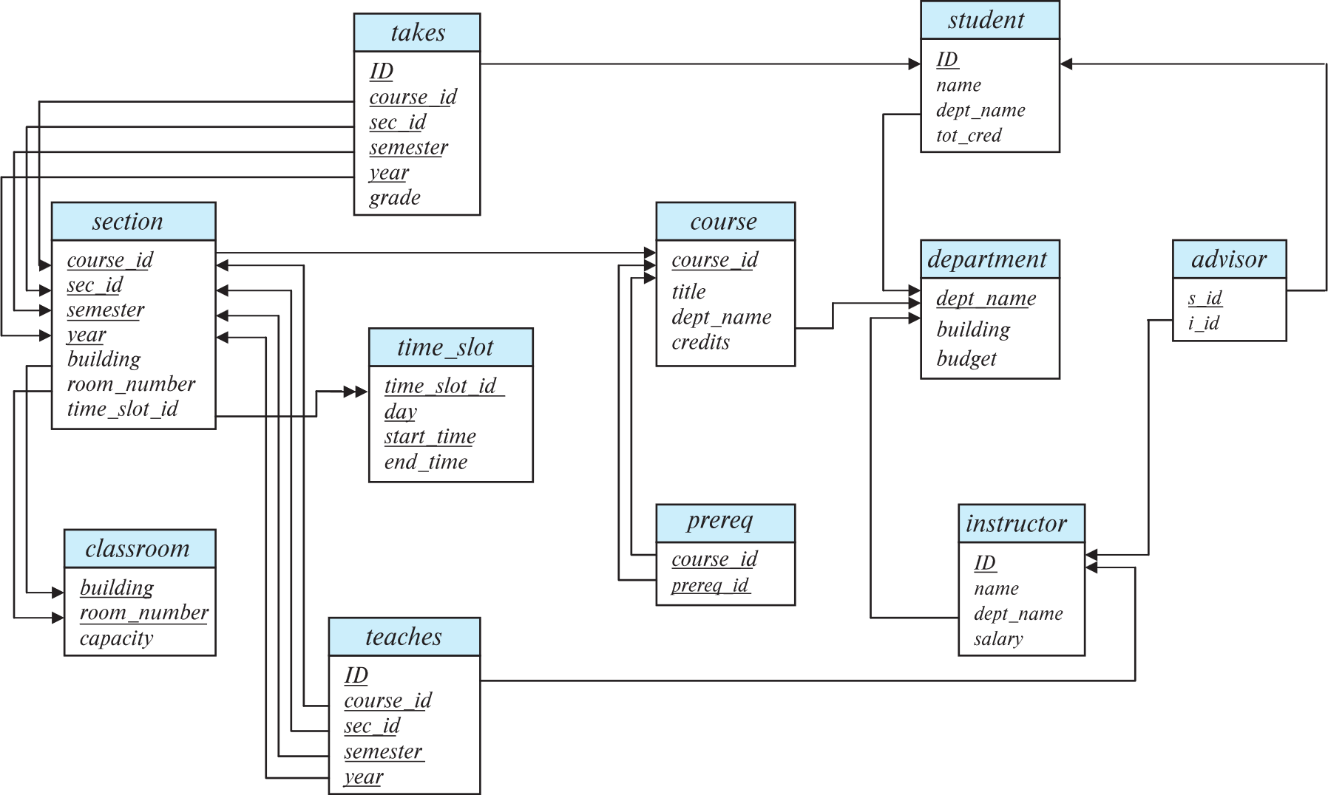
Schema Diagram for University Database

Slide 15
Relational Query Languages
The language in which the user requests information from the database
Procedural versus non-procedural, or declarative
“Pure” languages:
Relational algebra: procedural
Tuple relational calculus: non-procedural
Domain relational calculus: non-procedural
The above 3 pure languages are equivalent in computing power
We will concentrate in this chapter on relational algebra
Not Turing-machine equivalent
Consists of 6 basic operations

Slide 16
Relational Algebra
A procedural language consisting of a set of operations that take one or two relations as input and produce a new relation as their result.
Six basic operators
select: σ
project: ∏
union: ∪
set difference: –
Cartesian product: x
rename: ρ
Select, project, rename – Unary operators: operate on one relation
Union, set difference, cartesian product – Binary operators

Slide 17
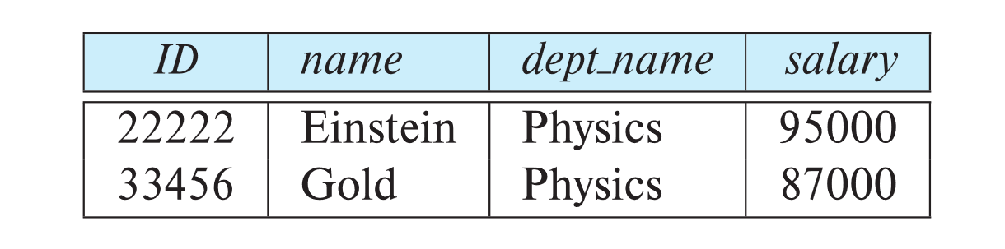
Select Operation
The select operation selects tuples that satisfy a given predicate.
Notation: σ _{p} (r)
p is called the selection predicate
Example: select those tuples of the instructor relation where the instructor is in the “Physics” department.
Query
σ _{dept_name=“Physics”} (instructor)
Result

Slide 18
Select Operation (Cont.)
We allow comparisons using
=, ≠, >, ≥. <. ≤
in the selection predicate.
We can combine several predicates into a larger predicate by using the connectives:
∧ (and), ∨ (or), ¬ (not)
Example: Find the instructors in Physics with a salary greater $90,000, we write:
σ _{dept_name=“Physics”} ∧ _{salary >} _{90,000} (instructor)
The select predicate may include comparisons between two attributes.
Example, find all departments whose name is the same as their building name:
σ _{dept_name=building} (department)

Slide 19
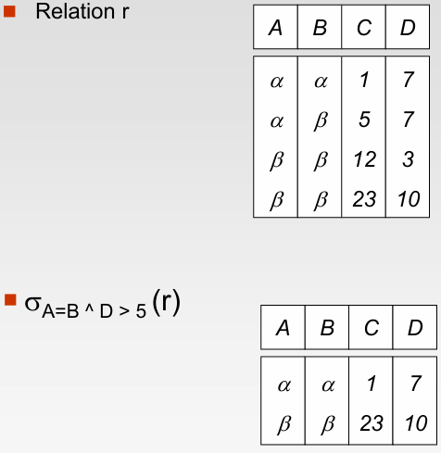
Select Operation (Cont.)

Slide 20
Project Operation
A unary operation that returns its argument relation, with certain attributes left out.
Notation:
∏ _{A1,A2,A3 ….Ak} (r)
where A₁, A₂, …, A_{k} are attribute names and r is a relation name.
The result is defined as the relation of k columns obtained by erasing the columns that are not listed
Duplicate rows removed from result, since relations are sets

Slide 21
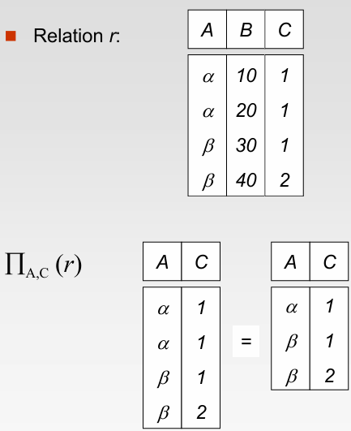
Project Operation Example

Slide 22
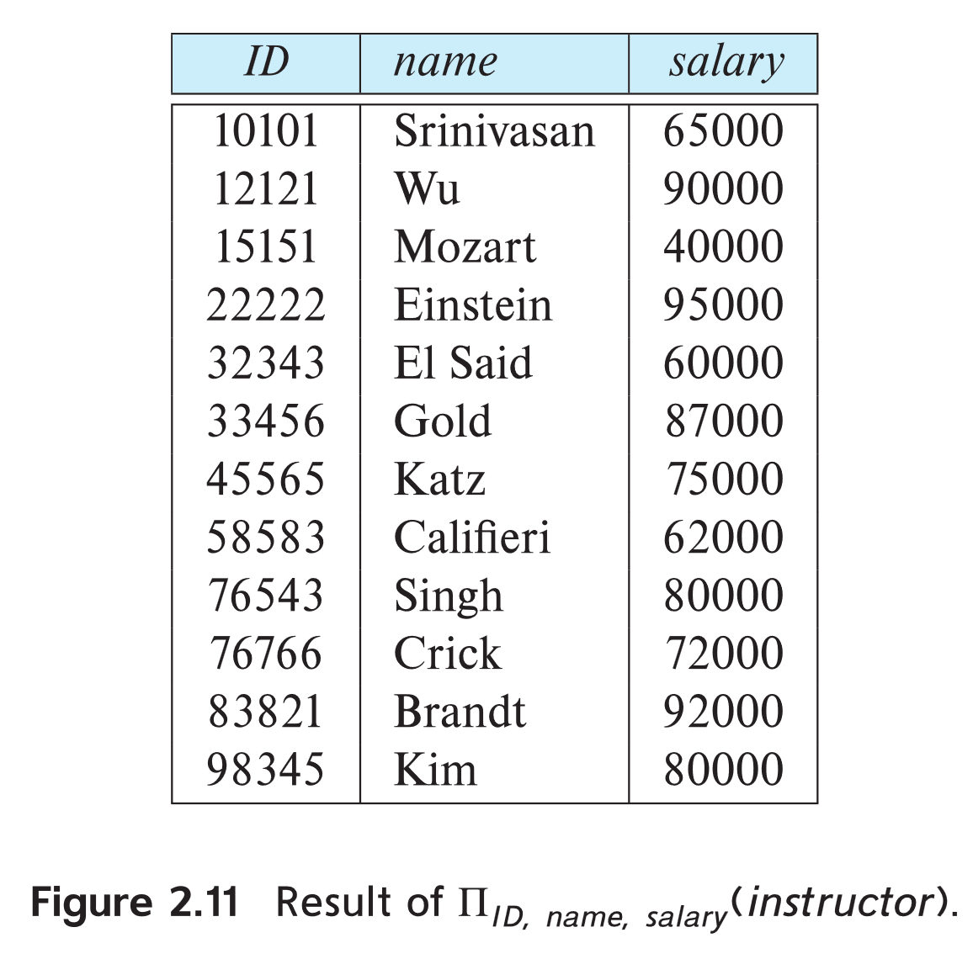
Project Operation Example
Example: eliminate the dept_name attribute of instructor
Query: ∏_{ID, name, salary} (instructor)
Result:

Slide 23
Composition of Relational Operations
The result of a relational-algebra operation is relation and therefore of relational-algebra operations can be composed together into a relational-algebra expression.
Consider the query -- Find the names of all instructors in the Physics department.
∏_{name}(σ _{dept_name} _{=“Physics”} (instructor))
Instead of giving the name of a relation as the argument of the projection operation, we give an expression that evaluates to a relation.

Slide 24
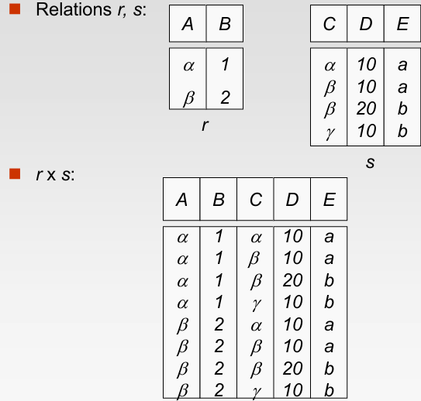
Cartesian-Product Operation

Slide 25
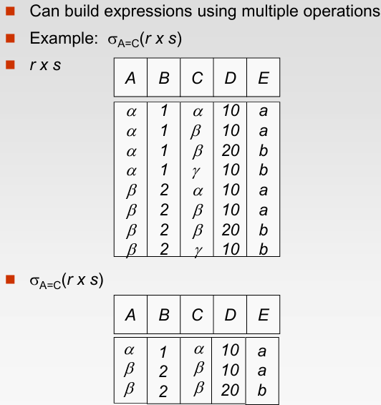
Composition of Operations

Slide 26
Cartesian-Product Operation
The Cartesian-product operation (denoted by X) allows us to combine information from any two relations.
Example: the Cartesian product of the relations instructor and teaches is written as:
instructor X teaches
We construct a tuple of the result out of each possible pair of tuples: one from the instructor relation and one from the teaches relation (see next slide)
Since the instructor ID appears in both relations we distinguish between these attribute by attaching to the attribute the name of the relation from which the attribute originally came.
instructor.ID
teaches.ID

Slide 27
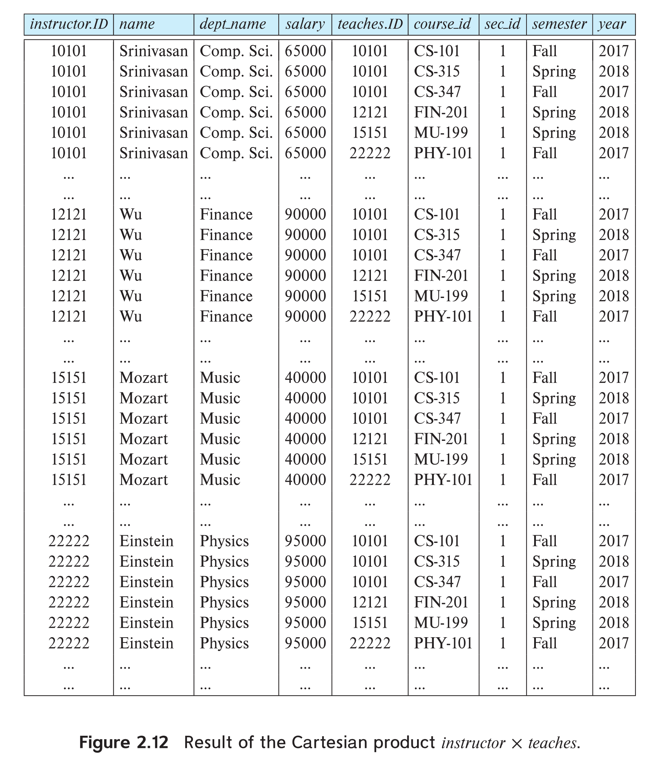
The instructor X teaches table

Slide 28
Join Operation
The Cartesian-Product
instructor X teaches
associates every tuple of instructor with every tuple of teaches.
Most of the resulting rows have information about instructors who did NOT teach a particular course.
To get only those tuples of “instructor X teaches “ that pertain to instructors and the courses that they taught, we write:
σ _{instructor.id = teaches.id} (instructor x teaches ))
We get only those tuples of “instructor X teaches” that pertain to instructors and the courses that they taught.
The result of this expression, shown in the next slide

Slide 29
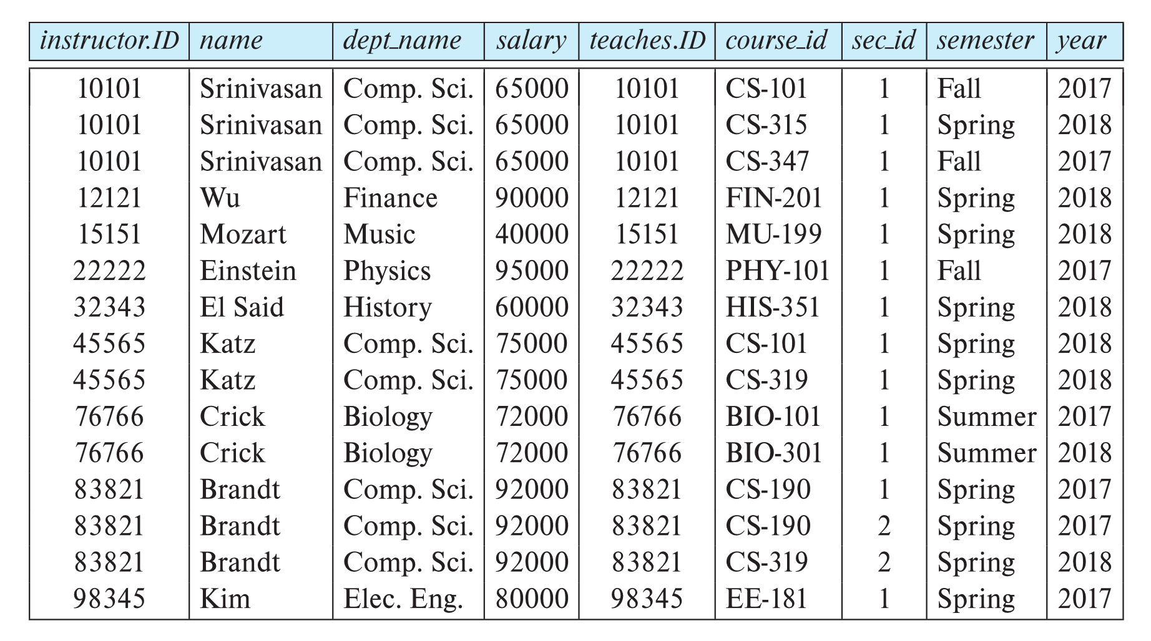
Join Operation (Cont.)
The table corresponding to:
σ _{instructor.id = teaches.id} (instructor x teaches))

Slide 30
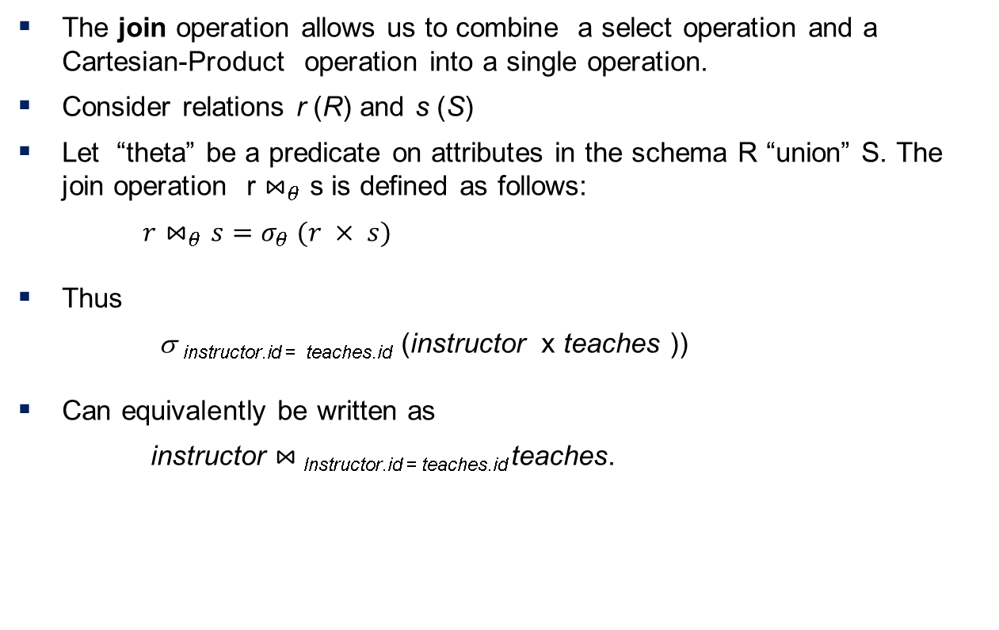
Join Operation (Cont.)
The join operation allows us to combine a select operation and a Cartesian-Product operation into a single operation.
Consider relations r (R) and s (S)
Let “theta” be a predicate on attributes in the schema R “union” S. The join operation r $⋈_{θ}$ s is defined as follows:
$r⋈_{θ}s=σ_{θ} (r × s)$
Thus
σ _{instructor.id = teaches.id} (instructor x teaches ))
Can equivalently be written as
instructor $⋈_{ }$_{Instructor.id = teaches.id} teaches.

Slide 31
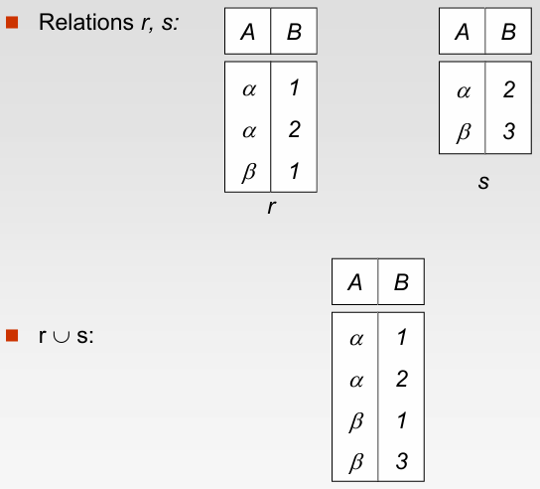
Union Operation

Slide 32
Union Operation
The union operation allows us to combine two relations
Notation: r ∪ s
For r ∪ s to be valid.
1. r, s must have the same arity (same number of attributes)
2. The attribute domains must be compatible (example: 2nd
column of r deals with the same type of values as does the
2nd column of s)
Example: to find all courses taught in the Fall 2017 semester, or in the Spring 2018 semester, or in both ∏_{course_id} (σ _{semester=“Fall” Λ year=2017} (section)) ∪ ∏_{course_id} (σ _{semester=“Spring” Λ year=2018} (section))

Slide 33
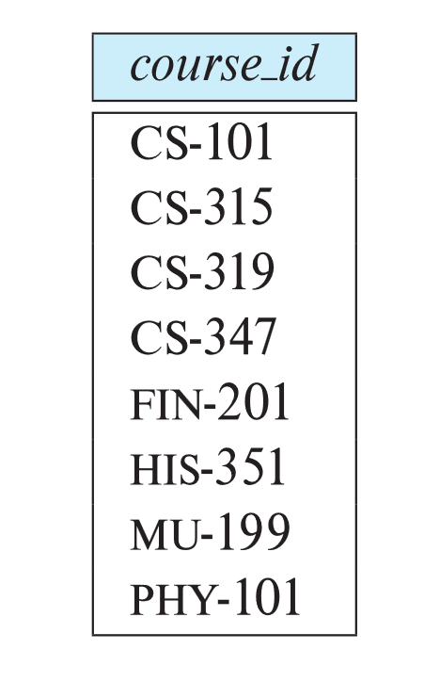
Union Operation (Cont.)
Result of: ∏_{course_id} (σ _{semester=“Fall” Λ year=2017} (section)) ∪ ∏_{course_id} (σ _{semester=“Spring” Λ year=2018} (section))

Slide 34
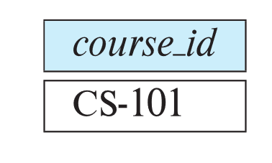
Set-Intersection Operation
The set-intersection operation allows us to find tuples that are in both the input relations.
Notation: r ∩ s
Assume:
r, s have the same arity
attributes of r and s are compatible
Example: Find the set of all courses taught in both the Fall 2017 and the Spring 2018 semesters.
∏_{course_id} (σ _{semester=“Fall” Λ year=2017} (section)) ∩ ∏_{course_id} (σ _{semester=“Spring” Λ year=2018} (section))
Result

Slide 35
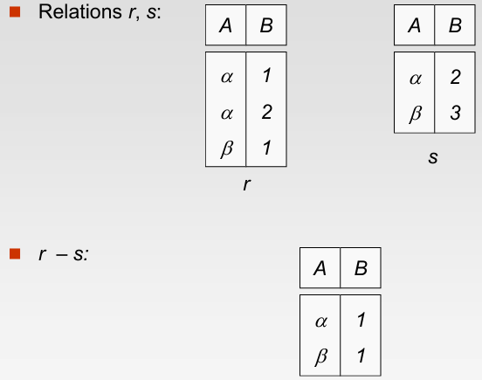
Set Difference Operation

Slide 36

Set Difference Operation
The set-difference operation allows us to find tuples that are in one relation but are not in another.
Notation r – s
Set differences must be taken between compatible relations.
r and s must have the same arity
attribute domains of r and s must be compatible
Example: to find all courses taught in the Fall 2017 semester, but not in the Spring 2018 semester ∏_{course_id} (σ _{semester=“Fall” Λ year=2017} (section)) − ∏_{course_id} (σ _{semester=“Spring” Λ year=2018} (section))

Slide 37
The Assignment Operation
It is convenient at times to write a relational-algebra expression by assigning parts of it to temporary relation variables.
The assignment operation is denoted by ← and works like assignment in a programming language.
Example: Find all instructor in the “Physics” and Music department. Physics ← σ _{dept_name=“Physics”} (instructor)
Music ← σ _{dept_name=“Music”} (instructor)
Physics ∪ Music
With the assignment operation, a query can be written as a sequential program consisting of a series of assignments followed by an expression whose value is displayed as the result of the query.

Slide 38
The Rename Operation
The results of relational-algebra expressions do not have a name that we can use to refer to them. The rename operator, ρ , is provided for that purpose
The expression:
ρ_{x} (E)
Returns the result of expression E under the name x
Another form of the rename operation:
ρ_{x(A1,A2, .. An)} (E)
Returns the result of expression E under the name X, and with the attributes renamed to A1, A2, …, An

Slide 39
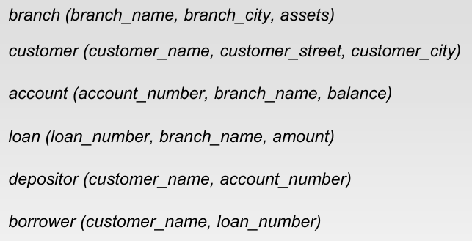
Banking Example

Slide 40
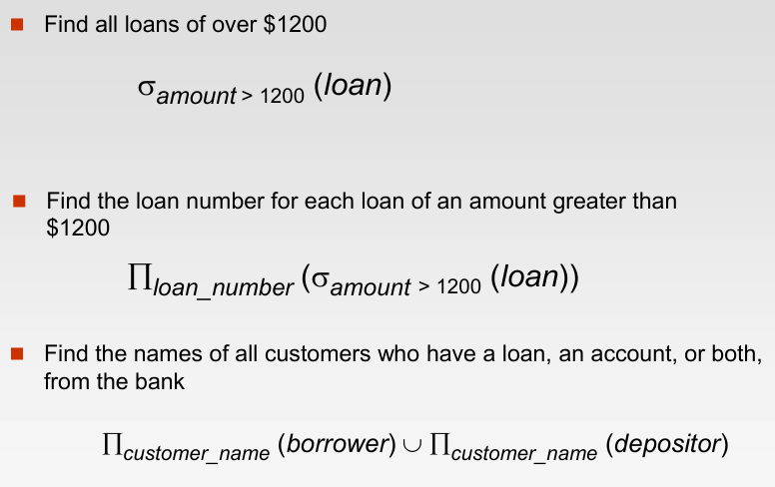
Example Queries

Slide 41
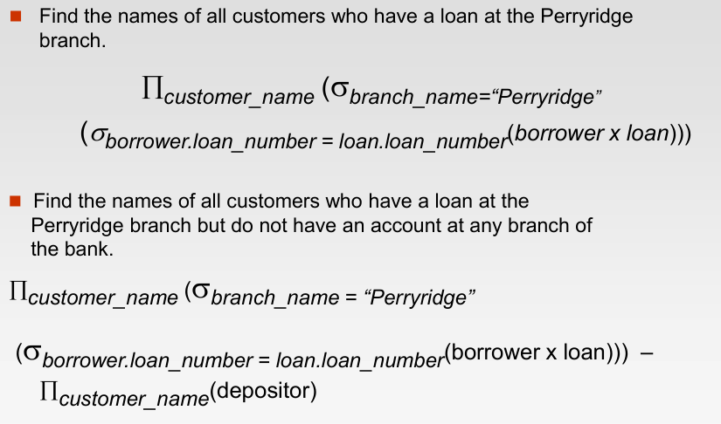
Example Queries

Slide 42
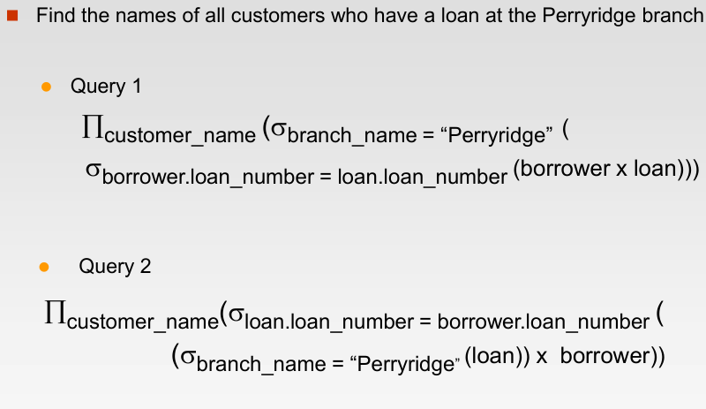
Example Queries

Slide 43
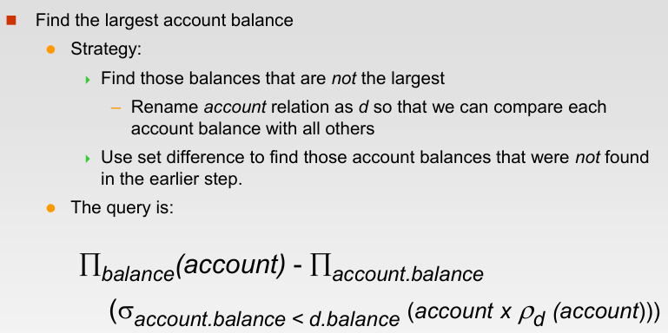
Example Queries

Slide 44
Equivalent Queries
There is more than one way to write a query in relational algebra.
Example: Find information about courses taught by instructors in the Physics department with salary greater than 90,000
Query 1
σ _{dept_name=“Physics”} ∧ _{salary > 90,000} (instructor)
Query 2
σ _{dept_name=“Physics”} (σ _{salary > 90.000} (instructor))
The two queries are not identical; they are, however, equivalent -- they give the same result on any database.

Slide 45
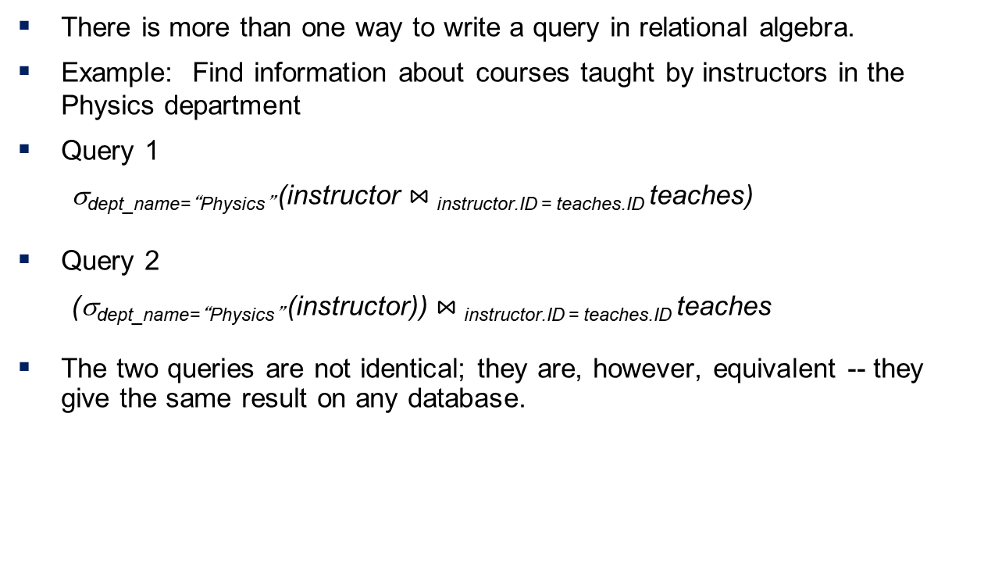
Equivalent Queries
There is more than one way to write a query in relational algebra.
Example: Find information about courses taught by instructors in the Physics department
Query 1
σ_{dept_name=“Physics”} (instructor $⋈_{ }$_{instructor.ID = teaches.ID} teaches)
Query 2
(σ_{dept_name=“Physics”} (instructor)) $⋈_{ }$_{instructor.ID = teaches.ID} teaches
The two queries are not identical; they are, however, equivalent -- they give the same result on any database.

Slide 46
End of Chapter 2

